Slide 1



PROJECT HEALTH CARE SYSTEM
PRESENTED BY TEAM:
LOGESHWARI S
MURUGAN C
MEDHARI RAVI TEJA
SANDEEP SANDILYA CHUNDURI
BHUVANESHWARI S
VAISHNAVI N

Slide 2

CONTENTS
Introduction
Tech Stack Overview
Use Case Diagram
Customer
Admin
Class Diagram
Application Architecture
Architecture layers in action
– Entity, Repository, Service, Controller, Dto, Exception
API’s Used
A Visual with Screenshots
- Postman, PostgreSQL

Slide 3
INTRODUCTION
OVERVIEW
This system consists of various diagnostic centers, with their own tests in which the customers can opt for. The system should be accessible to two types of users, namely admin and customer.
Admin can control over adding, removing and updating diagnostic centers and the tests under them.
Customer makes an appointment for the test in particular diagnostic center. The appointment will be confirmed only after the admin approves it.
PURPOSE
Optimizing Healthcare Access: Revolutionizing Diagnostic Test Appointments for Enhanced Patient Convenience and Efficient Resource Management

Slide 4




Tech Stack Overview
Exploring the Technologies Employed in Our Project
JDK 17
Spring Boot
Postman
PostgreSQL
PROJECT:
Maven
DEPENDENCIES USED IN SPRING BOOT :
Spring Web
Spring Boot DevTools
Spring DATA JPA
PostgreSQL Driver
Model Mapper
UUID

Slide 5

USE CASE DIAGRAM:
CUSTOMER
REGISTER
LOGIN
SELECT DIAGNOSTIC CENTER
MAKE AN APPOINTMENT
CHECK APPOINTMENT STATUS

Slide 6

USE CASE DIAGRAM:
ADMIN
APPROVE APPOINTMENT
ADD DIAGNOSIS CENTER
DELETE DIAGNOSTIC CENTER
ADD TEST
DELETE TEST

Slide 7
CLASS DIAGRAM
USER
-userId:String -userName:String -age:Integer -gender:String -userEmail:String -contactNo:BigInteger -userPassword:String -userRole:String -centerList:List<DiagnosticCenter>
+addCenter +removeCenter +addTest +removeTest +approveAppointment +makeAppointment +register
TEST
-testId:String -testName:String
DIAGNOSTIC CENTER
-centerId:String -centerName:String -listOfTests:List<Test> -appointmentList:List<Appointment>
* 1
* 1
* 1
APPOINTMENT
-userId:String -appointmentId:BigInteger -test:Test -datetime:Datetime -approved:Boolean -center:DiagnosticCenter
1 *
1 1

Slide 8
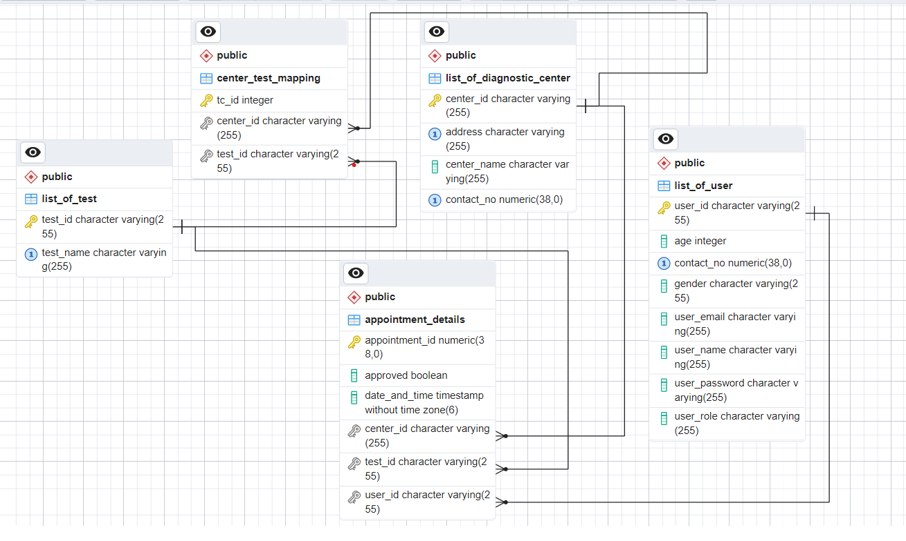
ER DIAGRAM

Slide 9

APPLICATION ARCHITECTURE
Persistence Logic: By using DAO layer persisted all the required to data base.
API’s
Different types of API’s used like:
Register and login user
Adding, Deleting Diagnostic Center and Tests etc
DTO’s
User
Diagnostic Center
Test
Appointment
DATABASE
(POSTGRESQL)
CONTROLLER
SERVICE
DAO
(REPOSITORY LAYER}
POST MAN
Client
JSON
Shows output as Json format
DataBase: All the persisted Data will be stored in DATA base by using PostgreSQL.
Business Logic: Implemented business Logic on adding and removing diagnostic Center and Tests. And implemented Registration, Exception and Validation part by using Service layer.

Slide 10
ARCHITECURAL LAYERS IN ACTION
Unveiling the DTO, Entity, Controller, Service, Repository and Exceptions Layers in our Application
@DTO Layer
The DTO layer consists of classes:
UserDto
DiagnosticCenterDto
TestDto
AppointmentDto.
@Controller Layer
The controller layer consists of classes:
UserContoroller
DiagnosticCenterController
TestController.
DTO Layer
Responsible for encapsulating and transporting data between different layers of an application.
CONTROLLER
Handles user input, processes requests, and manages the flow of data between the model and view layers.

Slide 11
ARCHITECURAL LAYERS IN ACTION
@Entity Layer
The Entity Layer consists of classes:
User
DiagnosticCenter
Test
Appointment
CenterTestMapping
ENTITY
Represents the business objects or data structures in an application, typically mapped to a database, and embodies the core business logic.

Slide 12
ARCHITECURAL LAYERS IN ACTION
@Service Layer
The Service Layer consists of
Interfaces:
UserService
DiagnosticCenterService
TestService
Classes:
UserServiceImpl
DiagnosticCenterServiceImpl
TestServiceImpl
SERVICE
Business logic implementations

Slide 13
ARCHITECURAL LAYERS IN ACTION
@Repository Layer
The Repository Layer consists
UserRepository
DiagnosticCenterRepository
Test Repository
Appointment Repository
CenterTestMappingRepository.
REPOSITORY
Serves as a bridge between the application and the database, handling data access and storage operations.

Slide 14
ARCHITECURAL LAYERS IN ACTION
@Exception Layer
GlobalExceptionHandler
ErrorInfo
IdAlreadyExistsException
IdNotFoundException
InvalidContactNumberException
InvalidEmailIdException
InvalidPassworedException
InvalidUserException
InvalidUserNameException
EXCEPTION
Handles and manages errors or unexpected events in a software application, ensuring graceful handling and reporting.

Slide 15
API’s USED
S.No | ENTITIES | HTTP/METHODS | API REQUESTS/ENDPOINTS | USAGE
1. | USER | POST | /api/v1/user/register | For adding diagnostic Center by Admin
 |  |  | /api/v1/user/login | For adding tests in diagnosticCenter by Admin
 |  |  | /api/v1/user/makeappointment | For making appointment By user
 |  | DELETE | /api/v1/user/cancelappointment/{appointmentid} | For Cancelling appointment By User
3. | Test | PUT | /api/v1/user/approveappointment/{userid}/{diagnosticcenterId} | For approving appointment by admin
 |  | GET | /api/v1/user/get | For listing out the Users
 |  |  | /api/v1/user/checkstatus/{appointmentid} | For checking appointment Status

Slide 16
API’s USED
S.No | ENTITIES | HTTP/METHODS | API REQUESTS/ENDPOINTS | USAGE
2. | Diagnostic Center | POST | /api/v1/diagnosticcenter/add/{userid} | For adding diagnostic Center by Admin
 |  |  | /api/v1/diagnosticcenter/addtest/{userid}/{cid}/{tid} | For adding tests in diagnosticCenter by Admin
 |  | DELETE | /api//v1/diagnosticcenter/deletecenter/{userid}/{cid} | For deleting diagnostic Center by Admin
 |  |  | /api/v1/diagnosticcenter/deletetest/{userid}/{cid}/{tid} | For deleting tests in diagnosticCenter by Admin
3. | Test | POST | /api/v1/test/add/{userid} | For adding tests in test table by Admin
 |  | GET | /api/v1/test/get | For list of Tests
 |  |  | /api/v1/test/get/{id} | For list of Test by Id
 |  | DELETE | /api/v1/test/deletetest/{userid}/{testid} | For Removing tests from test list by Admin

Slide 17
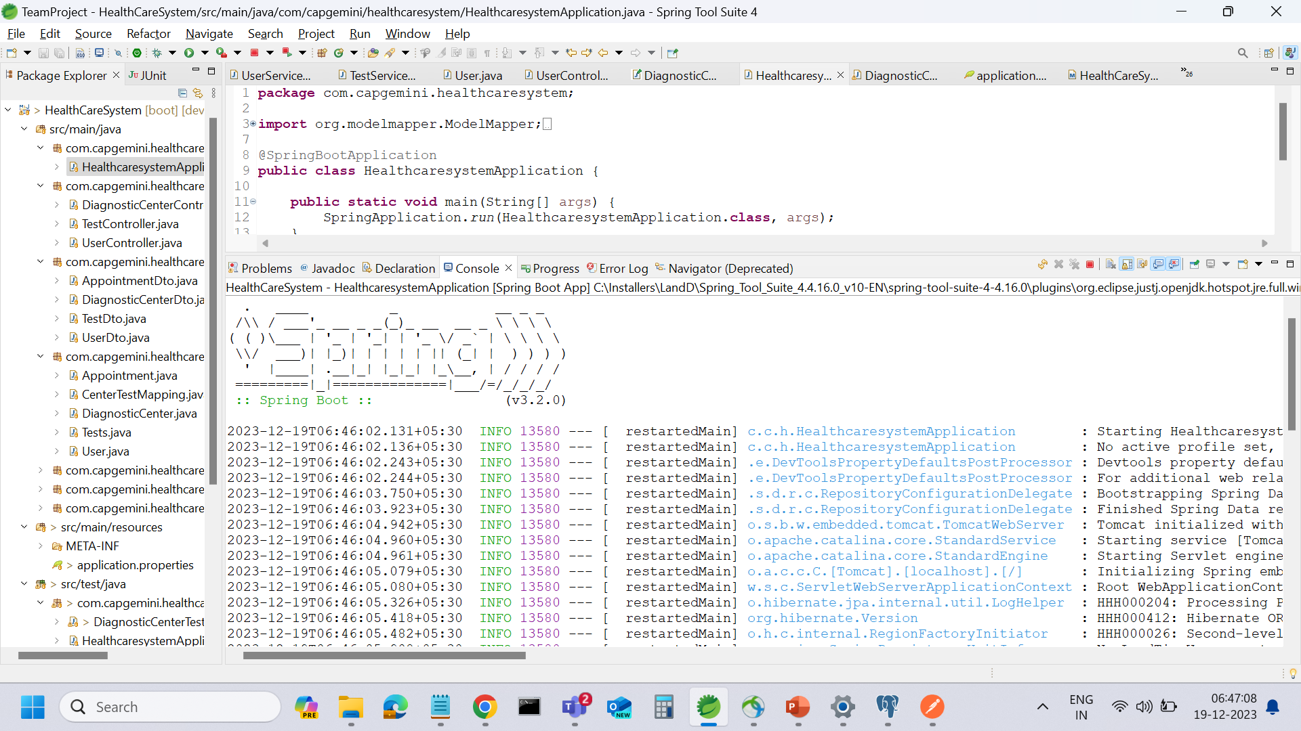
A Visual with Screenshots
Running application

Slide 18
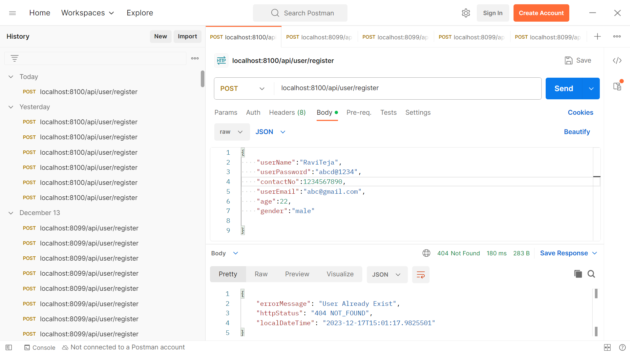
A Visual with Screenshots
Request Configuration in Postman

Slide 19
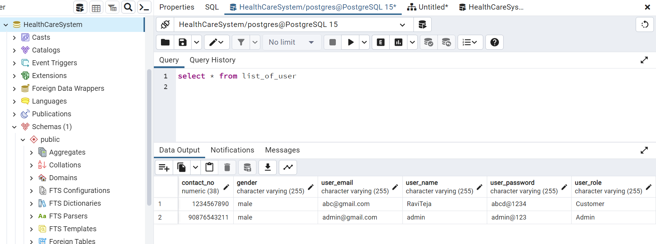
A Visual with Screenshots
PostgreSQL Interaction

Slide 20
THANK YOU

